Slide 1
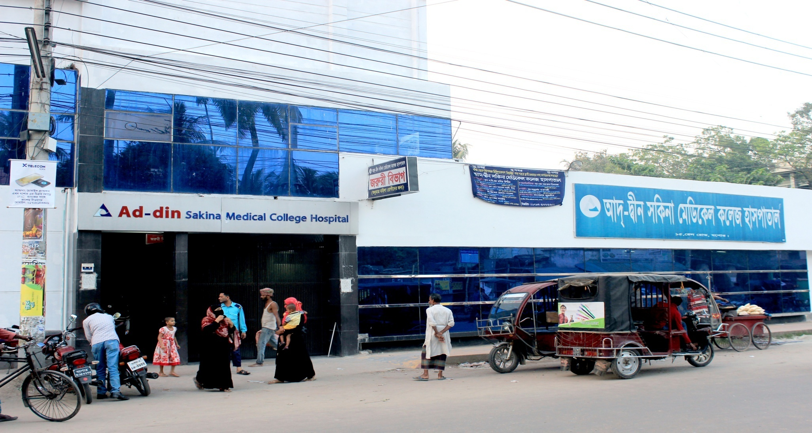
Ad-din Sakina Women’s Medical College Hospital
Prof. Dr. Hasanuzzaman
Dept. of Obs & Gynae

Slide 2

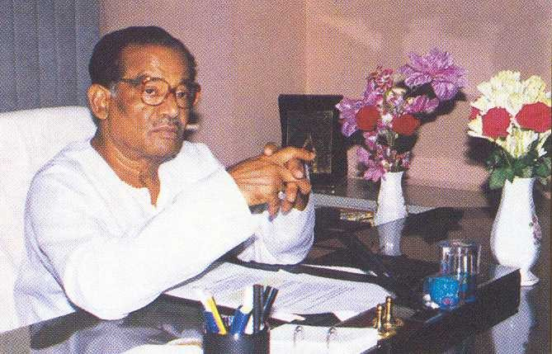
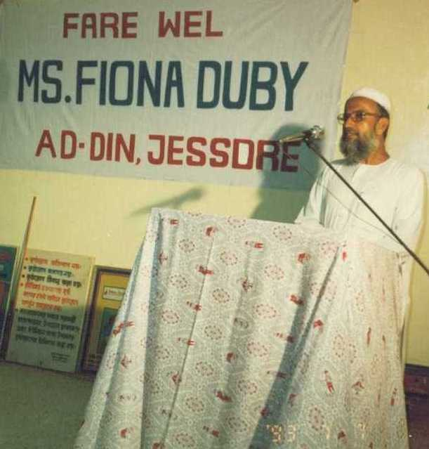

Founder of Ad-din
Late Sheikh Akijuddin
Founder Chairman
Established Ad-din out of corporate social responsibility.
Founder of Akij Group with 20 business units.
Late Prof. Sharif Hossain
Founder of lot of social organizations, educationist, recipient of Ekushe Padak.
Dr. Sheikh Mohiuddin
Founder Executive Director

Slide 3


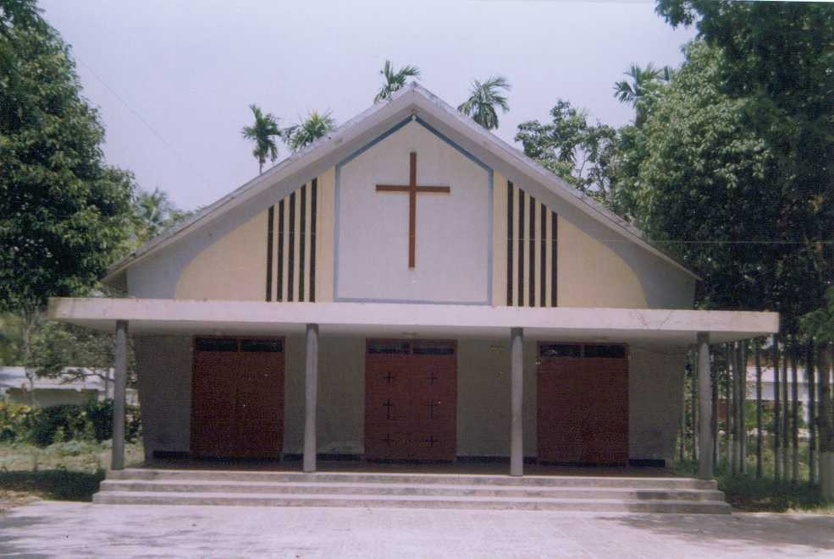
Core Values
To respect and take care of the cultural & religious values of our country as a part of development

Slide 4

Ad-din Sakina Women’s Medical College Hospital
Background History
Started as an orphanage at Khuladanga, Jashore in 17 December 1980.
Ad-din Hospital Started in 5 April 1985 with the aim of providing standard MCH service with minimum cost .
Ad-din Nursing Institute started in 1997.
Ad-din Medical Technology Institute started in 2004.
Ad-din Sakina Women’s Medical College started in 2011

Slide 5



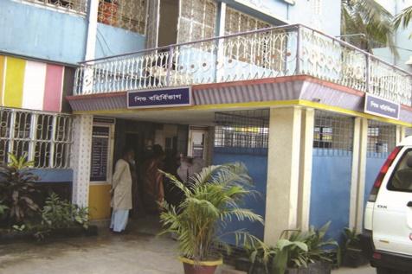
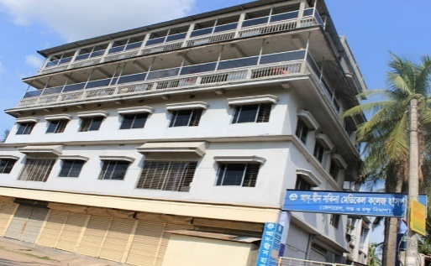
Ad-din Hospitals
Ad-din Medical College Hospital, Dhaka
Estd. 1 Nov 1997
500-Bed
Ad-din Sakina Women’s Medical College Hospital, Jessore
Estd. 4 April 1985
500-Bed
Ad-din Akij Medical College Hospital, Khulna
Estd. 8 Feb 2013
500-Bed:.
Bashundhara Ad-din Medical College Hospital, Keraniganj, Dhaka
Estd. 25 Feb 2012
300-Bed.
Ad-din Hospital, Kushtia
Estd. 1 Nov 1999; 100-Bed
Ad-din Barrister Rofique-Ul Huq Hospital, Postogola, Dhaka
Estd. May 2017; 300-Bed
Ad-din Child Hospital
Estd. 1 January1998; 100-Bed
Ad-din Eye Hospital, Jashore
Estd. 1st Sep 2003; 50-Bed

Slide 6



Nursing Institutes
Ad-din Nursing Institute, Jessore
Estd. Aug 1997
Fatema Nursing Institute, Dhaka Estd. Jul 2006
Safina Nursing Institute, Kushtia Estd. Sept 2005

Slide 7
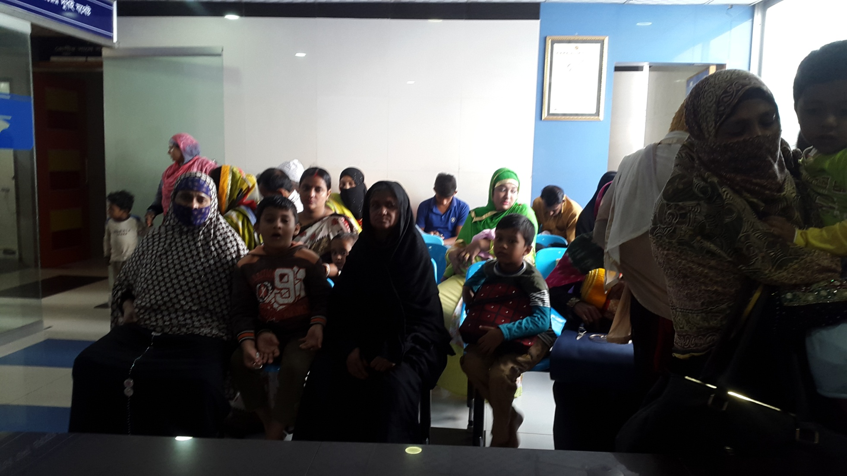
Ad-din Sakina Women’s Medical College Hospital Outdoor

Slide 8
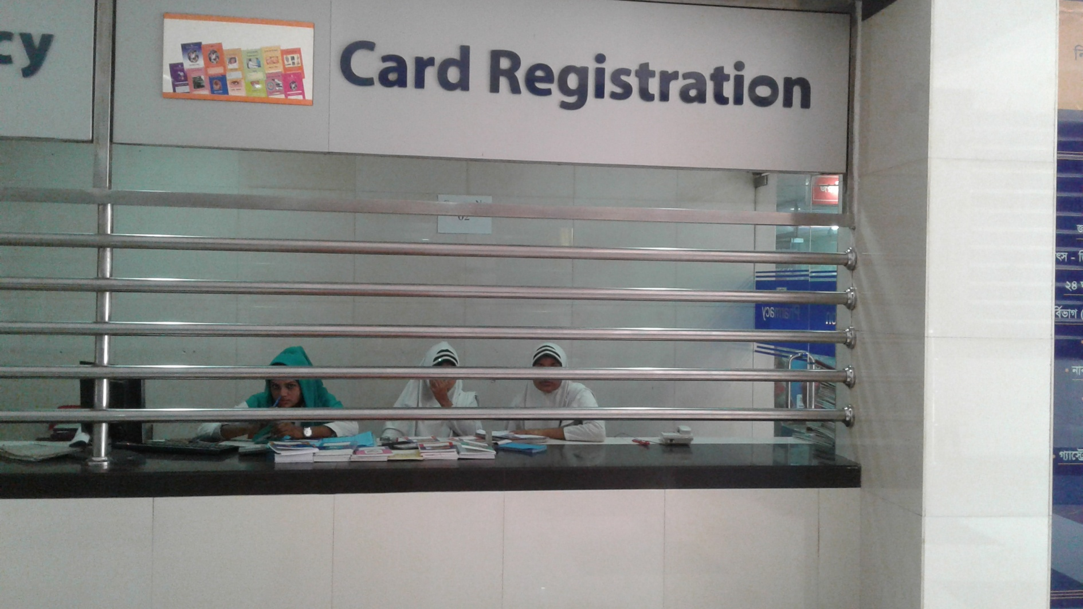
Card Registration

Slide 9
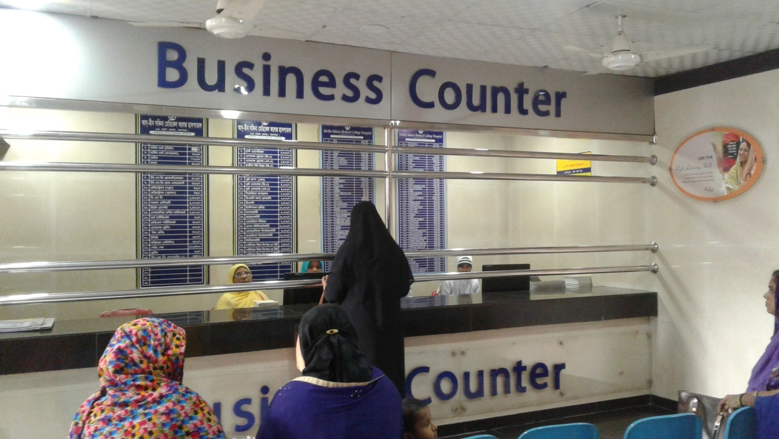
Business Counter

Slide 10
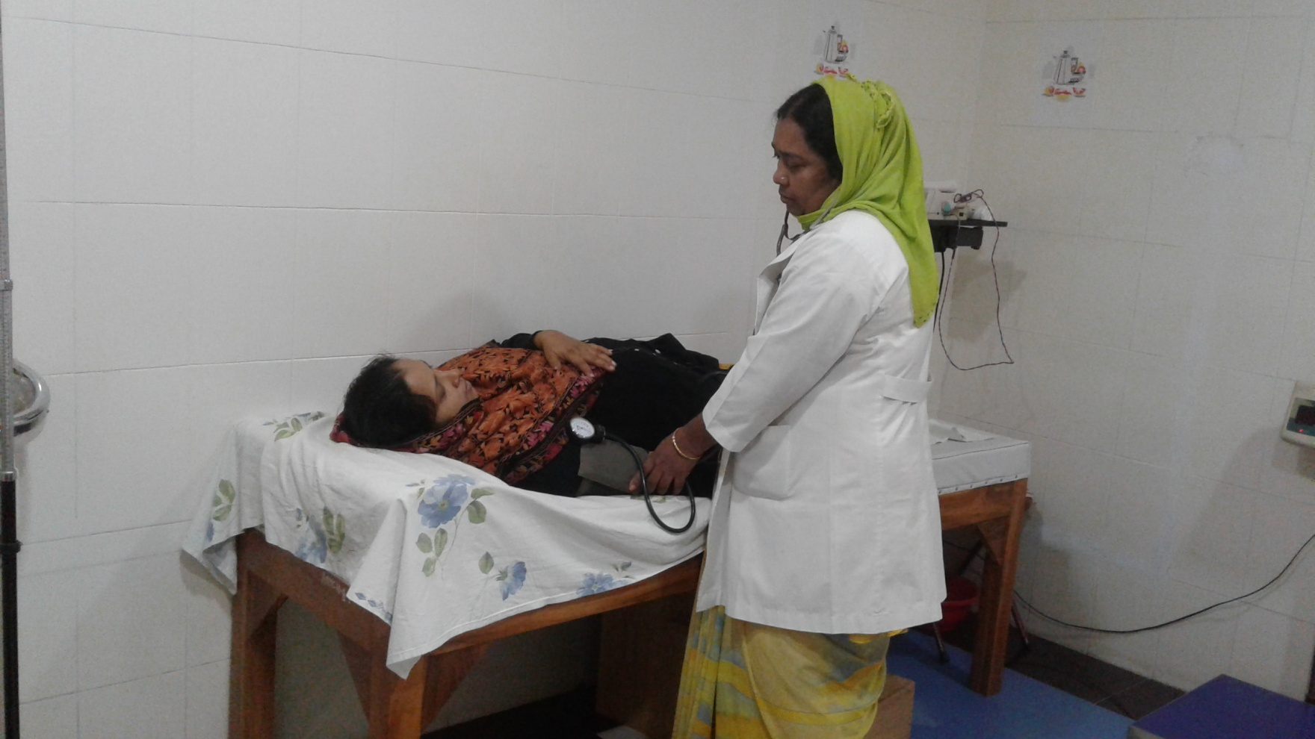
Antenatal Care

Slide 11
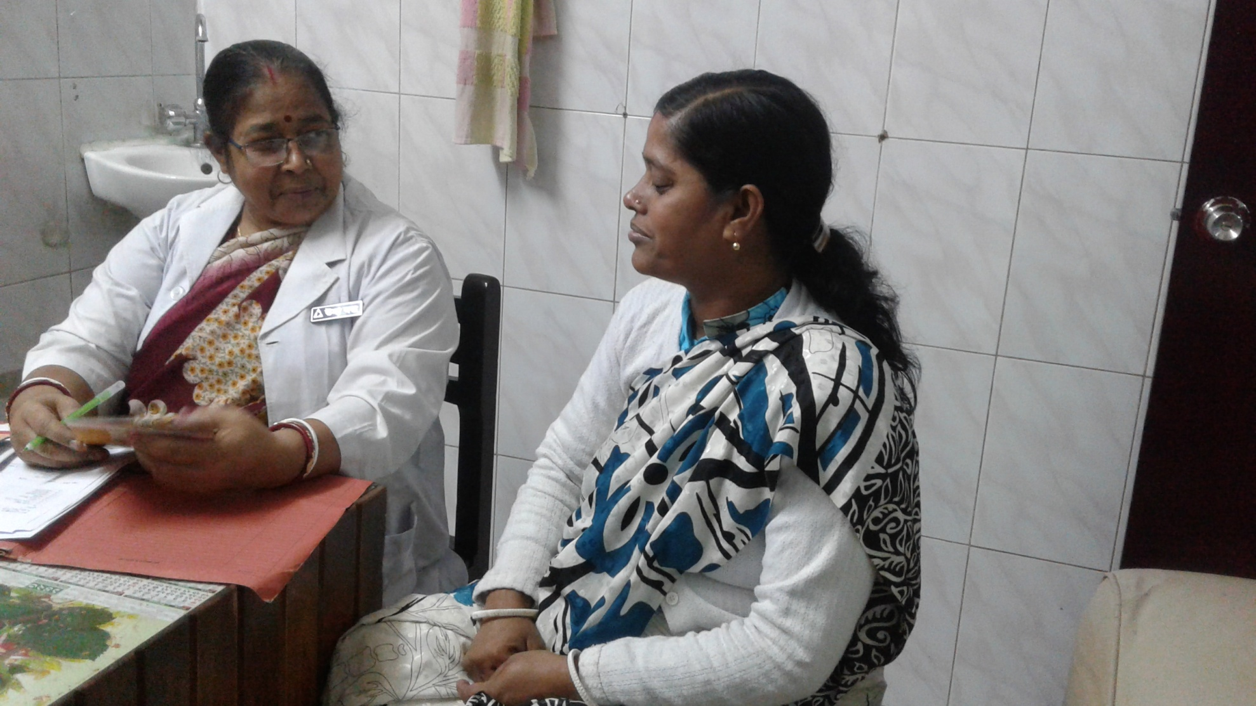
Family Planning

Slide 12
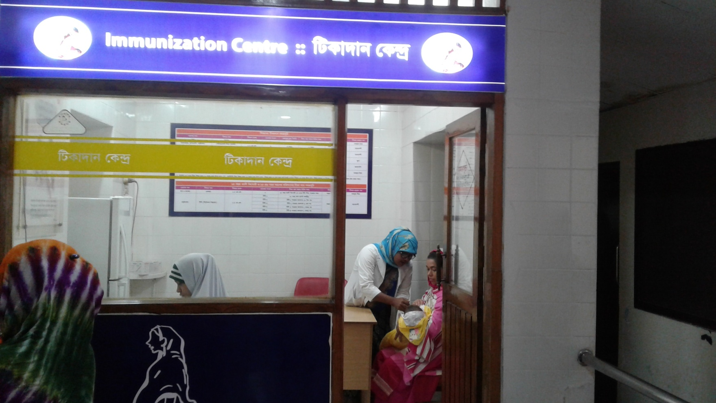
Immunization

Slide 13
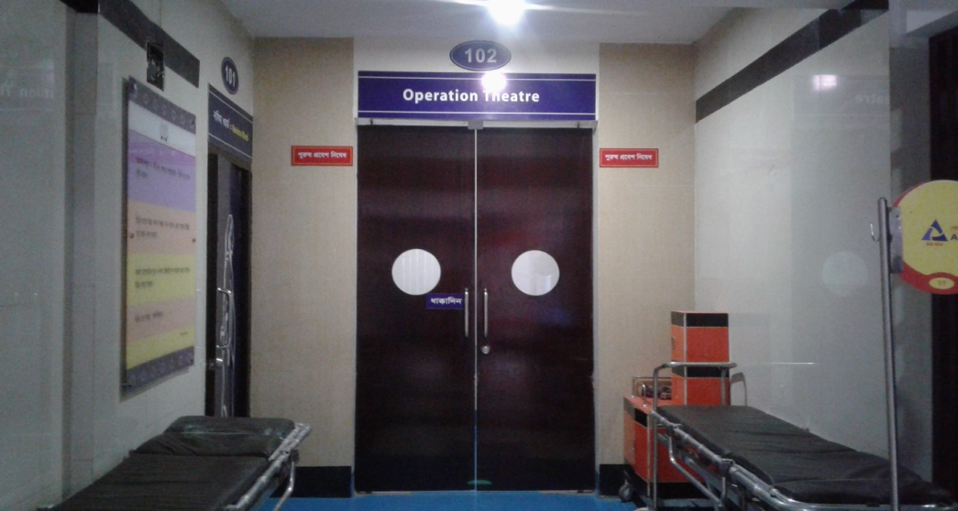
Operation Theatre

Slide 14
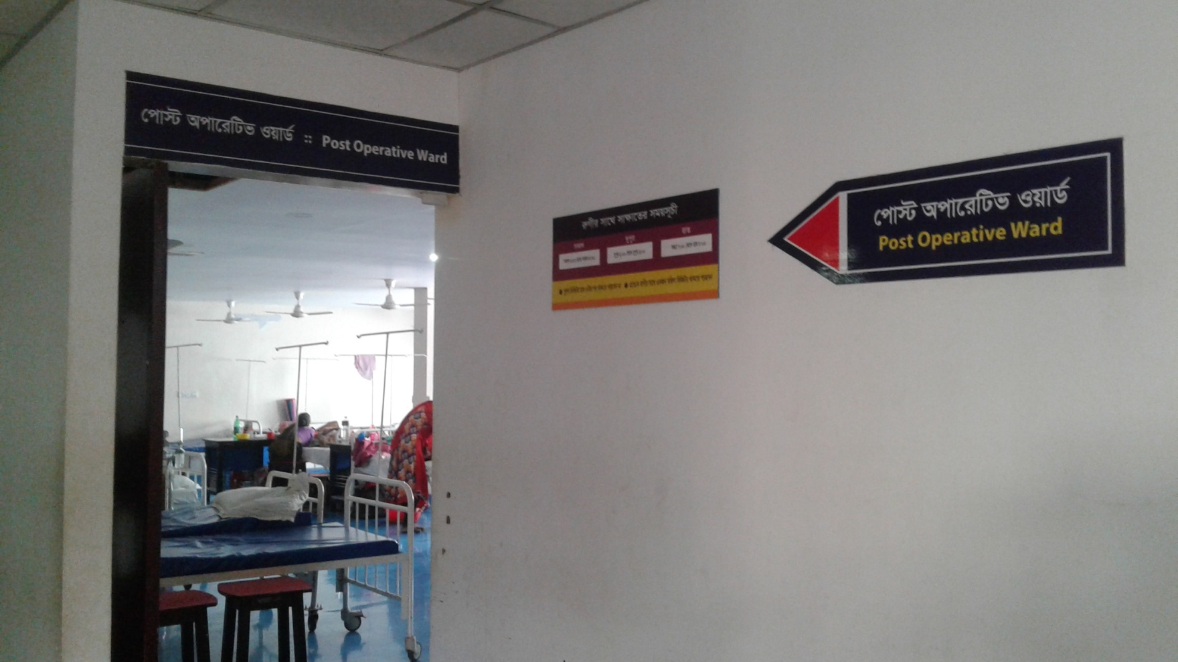
Post Operative Ward

Slide 15
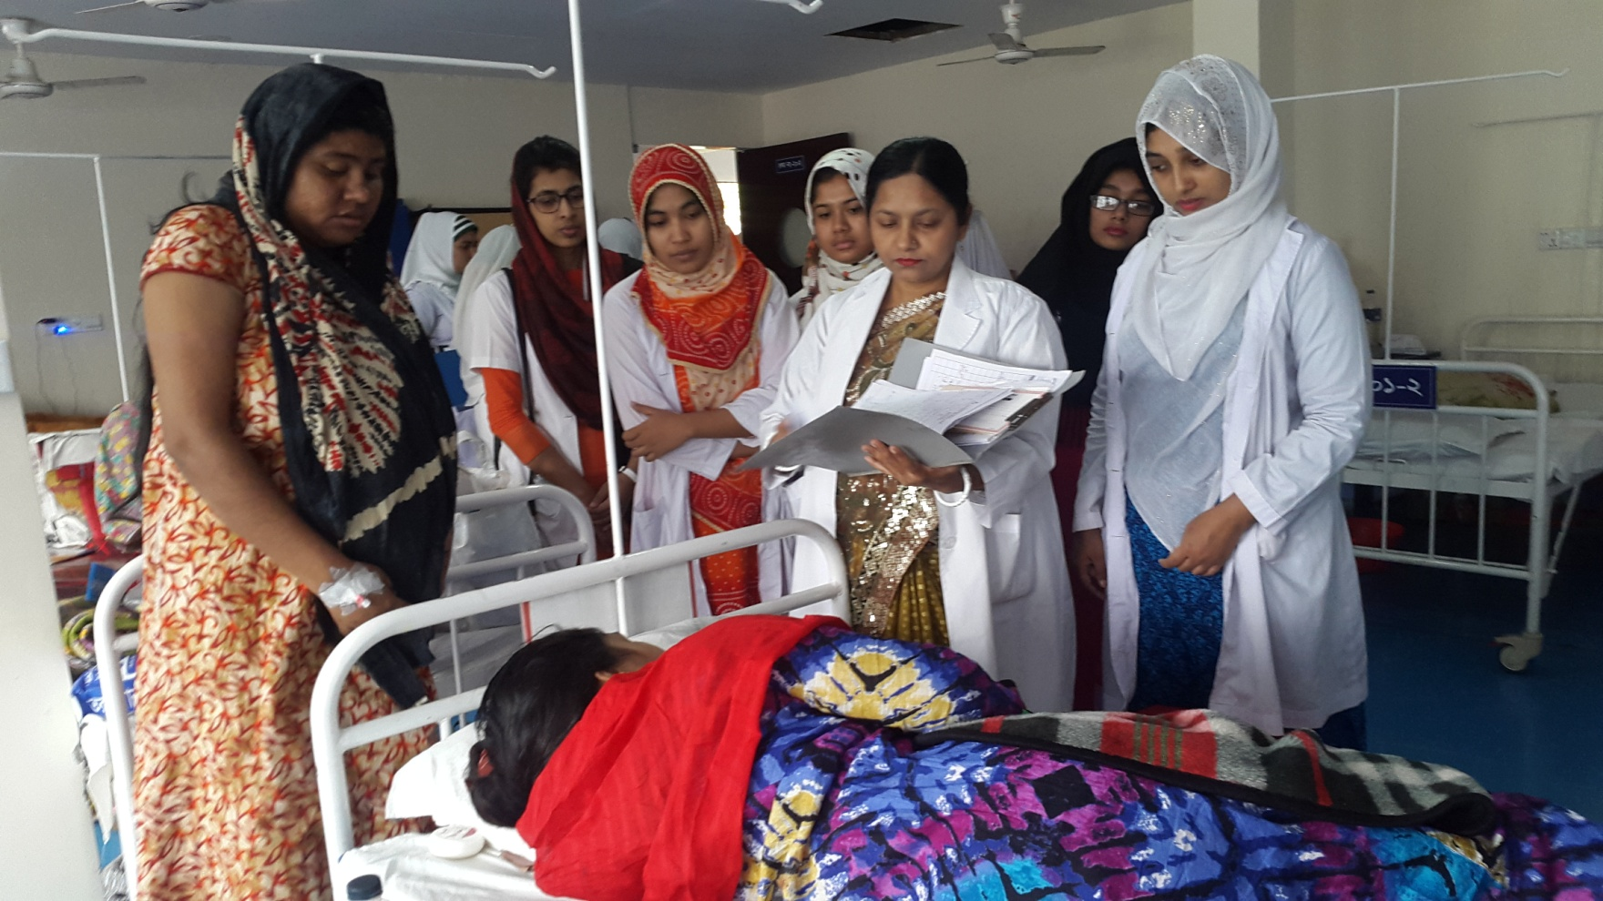
Gyane Ward

Slide 16
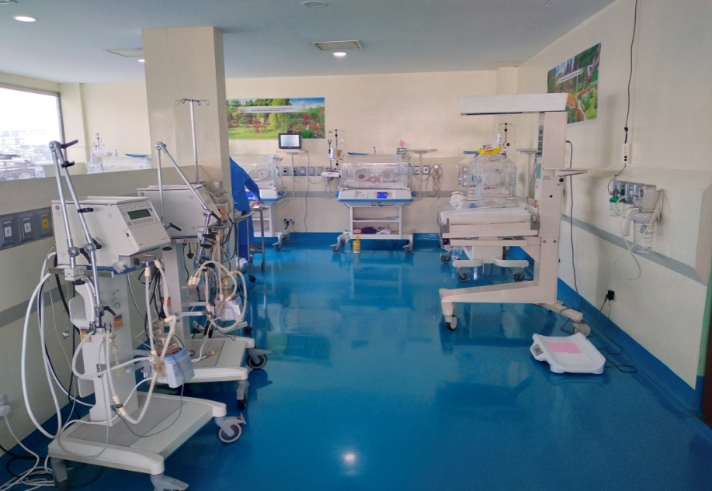
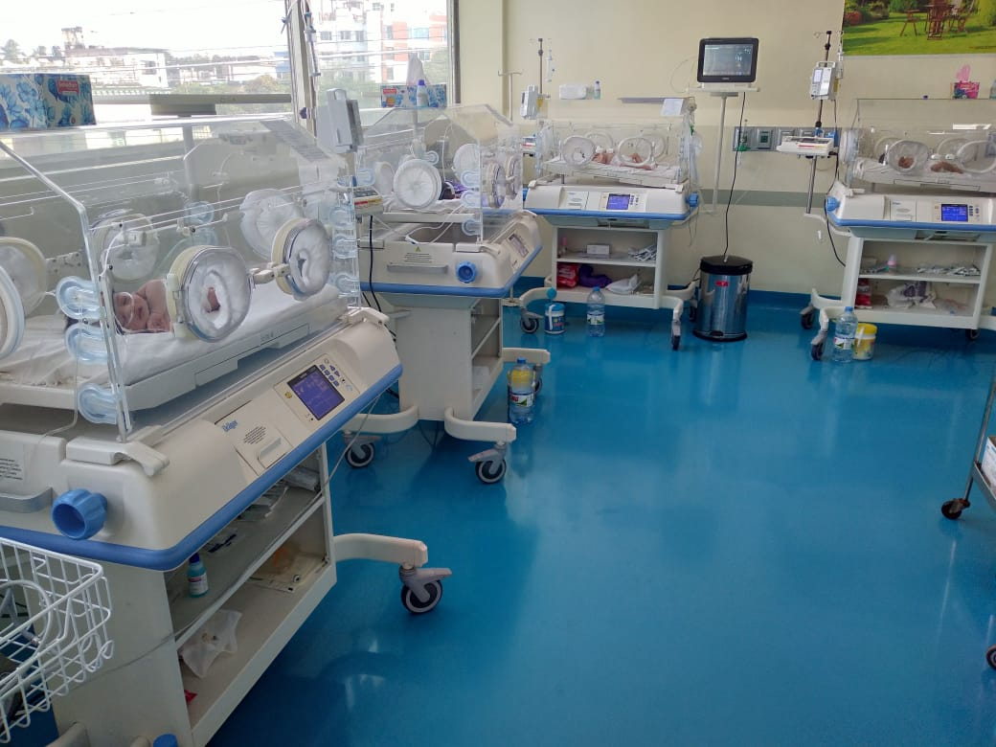
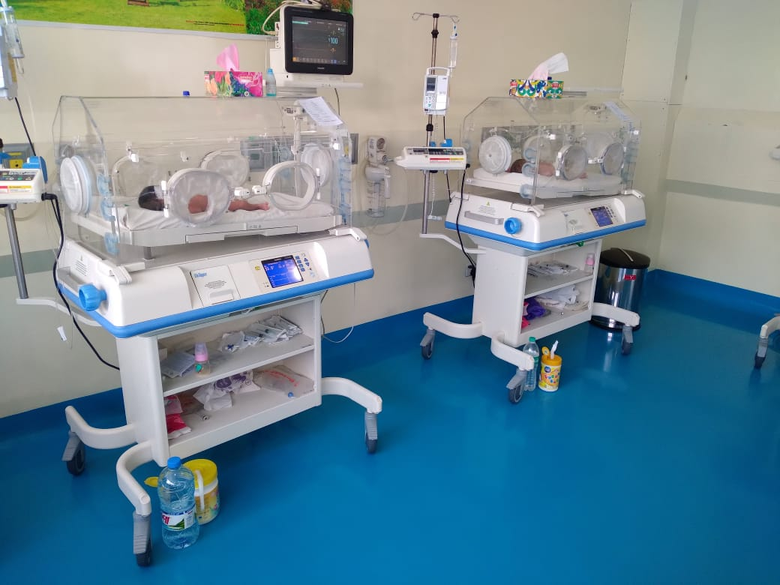
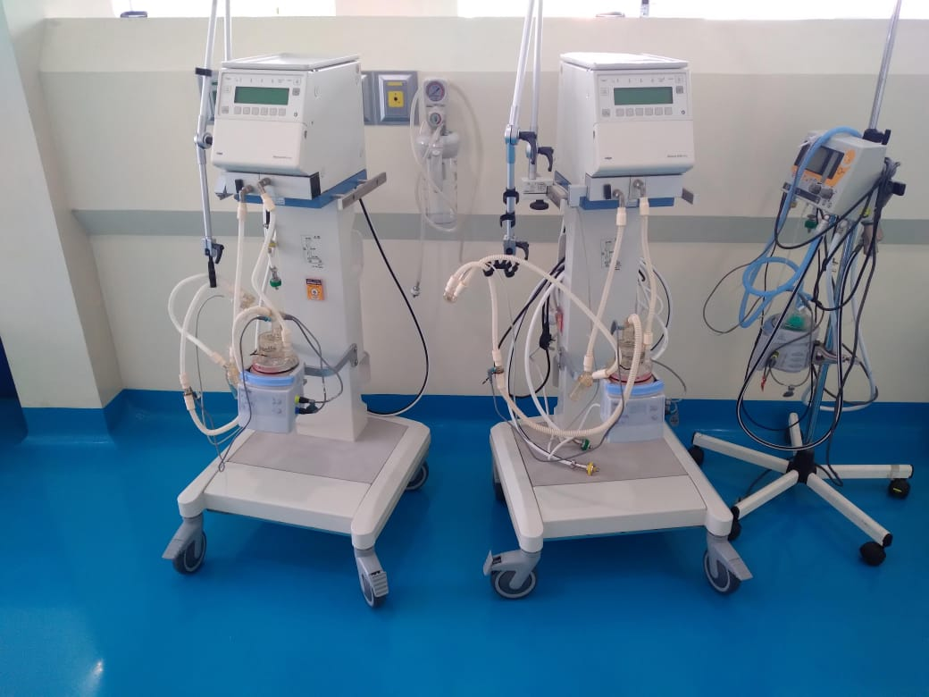
Neonatal Intensive Care Unit (NICU)

Slide 17
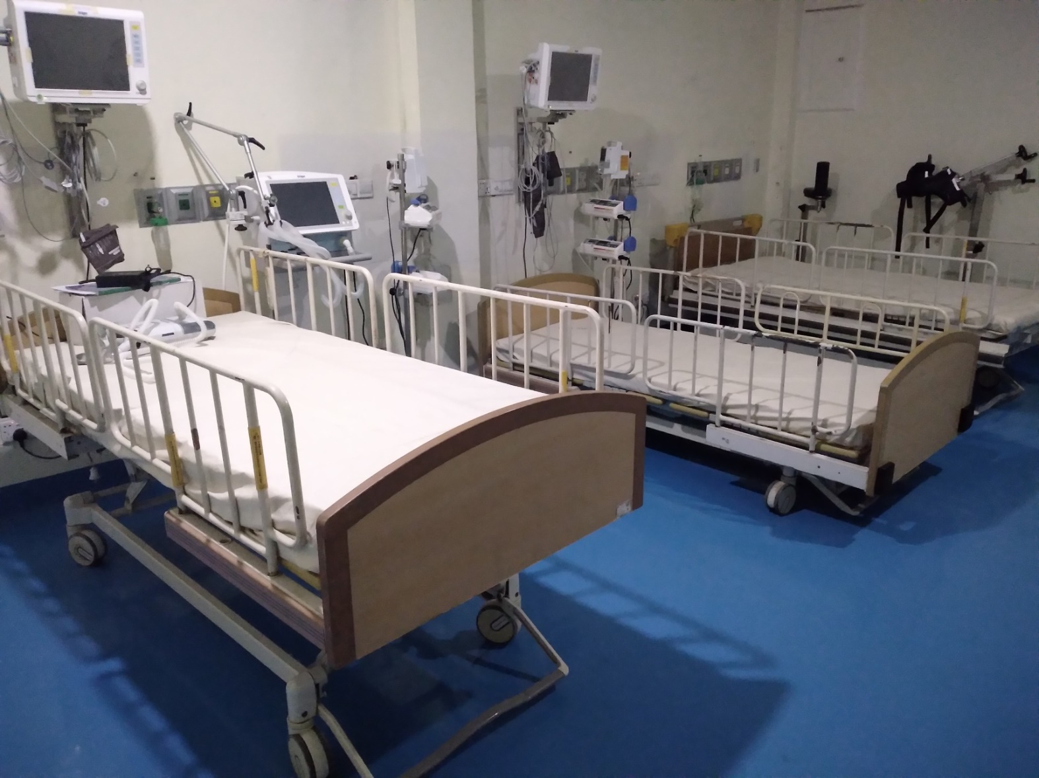
Maternal ICU

Slide 18
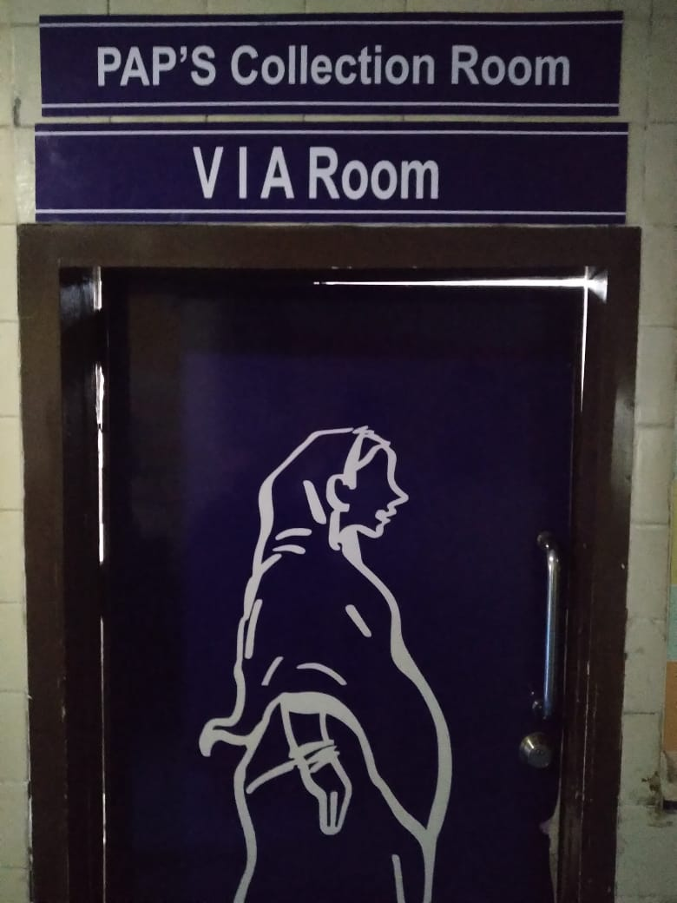
VIA Corner

Slide 19
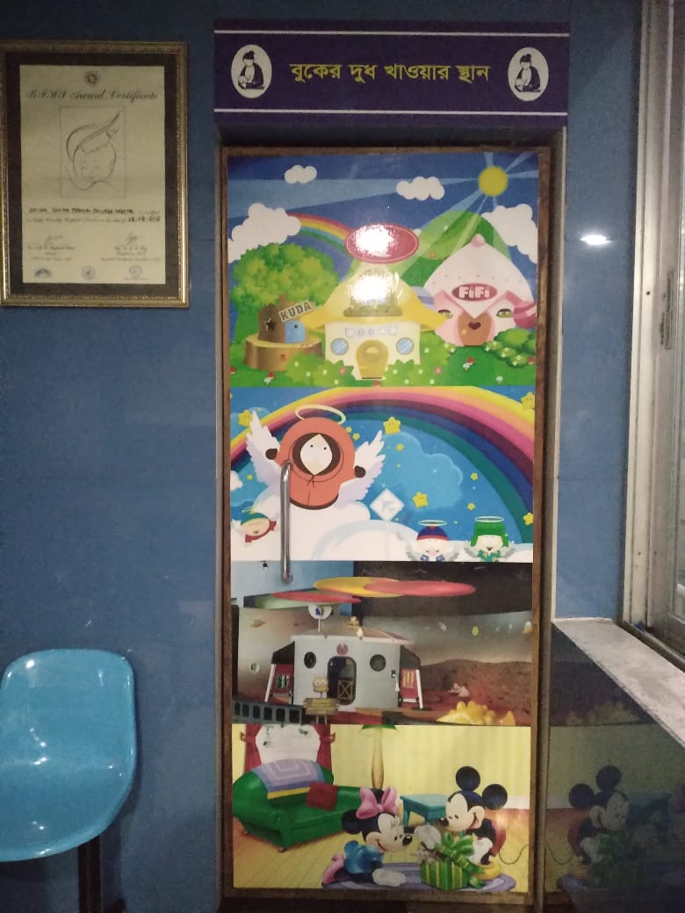
Breast Feeding Corner

Slide 20
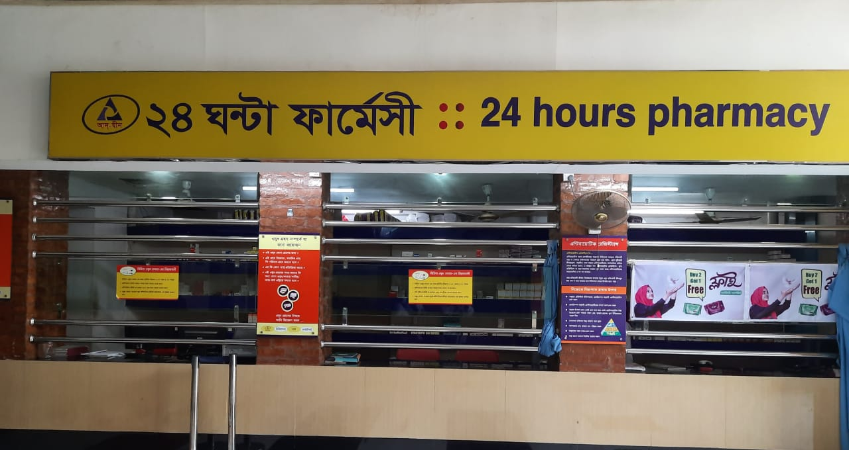
24 Hours Pharmacy

Slide 21
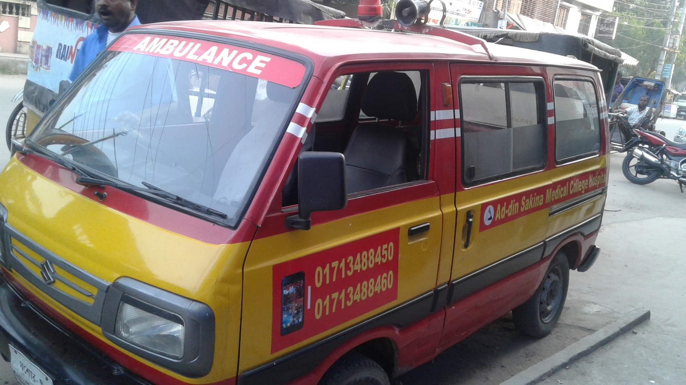
24 Hour Ambulance Service

Slide 22


Community Base Ambulance Service
12 Ambulance are serving in different area in community.
Speciality
Very low cost service (Less than 50% of market Price)
Full free at 8.00pm to 6.00am for Pregnant Mother.
Easy & Quick

Slide 23

Community Health Services
Working Area: 14 Districts | Community Midwife | 96
Monthly Satellite clinic | 2156

Slide 24

Fistula Care Project
Awareness Development Training
Patient Screening
Treatment – 223
Rehabilitation – 61
All Services are
free of cost

Slide 25
Name of the Doctors
Name | Designation
Prof. Dr. Badrunnesa Begum MBBS, FCPS, DGO, MCPS | Professor and Head
Prof. Dr. Md. Hasanuzzaman MBBS, FCPS | Professor
Prof. Dr. Md. Rabiul Islam MBBS, MCPS, DGO | Professor
Prof. Dr. Tarun Kanti Ghosh MBBS, MCPS, DGO, FCPS | Professor
Prof. Dr. Nikunjo Bihari Goldar MBBS, MCPS, DGO | Professor
Prof. Dr. Gour Kishor MBBS, FCPS | Professor
Dr. Nasrin Jahan Baker MBBS, MCPS, FCPS | Associate Professor
Dr. Md. Emdadul Haque MBBS, DMCH-FP, DGO | Associate Professor
Dr. Salaha Khatun MBBS, DMCHFP, DGO | Assistant Professor

Slide 26
Name of the Doctors
Name | Designation
Dr. Shila Podder | RS
Dr. Kumruzzaman | Registrar
Dr. Tonni Moni Chonda | Assistant Registrar
Dr. Sumayya Sharmin | Medical officer
Dr. Tahmina Sharmin | Medical officer
Dr. Sultana Zaman | Medical officer

Slide 27
Academic activities
Training of Intern Doctors:
  Morning Session
  Case Presentation
  Discussion on referred case
  Training according to log book.
5th year MBBS Class
4th year MBBS Class
Nursing Training

Slide 28
Academic activities
Ongoing Research study :
  Wound infection
  Premature Rupture Of Membrane(PROM)
  Intra Uterine Fetal Death (IUD)

Slide 29
Annual Trend of ANC Services

Slide 30
Comparison between NVD and C-Section

Slide 31
Patients admitted in Obs. ward (Jan-Nov) 2021
Title | Number
Pregnancy with Previous C/S | 580
Pregnancy with Lower abdominal pain | 581
Pregnancy with Less fetal movement | 454
Pregnancy with PROM | 330
Pregnancy with UTI | 424
Pregnancy with Ante partam haemorrhage | 157
Pregnancy with Anaemia | 943
Post Dated Pregnancy | 58
PE and PIH | 349
Term pregnancy with labour pain | 632
Hyperemesis graviderum | 208
Pregnancy with Oligohydramnios | 512
Pregnancy with PUO | 87
IUD | 14
GDM | 58
Pregnancy with Breech Presentation | 34

Slide 32
Gynae operation list(Jan-Nov-2021)
Total abdominal hysterectomy | 300
Sub total abdominal hysterectomy | 40
Vaginal Hysterectomy | 25
Laparotomy | 150
Ovarian cystectomy | 14
Perineal tear Repair | 72
Hydratidiform Mole | 17
DE&C | 429
Biopsy | 26
Bartholin cyst | 24
Total = | 1097

Slide 33
Performance of gynae and obst Department from 2010-2021(Jan-Nov)
Year | Total IPD Patients | Total OPD Patients | Gynae Patients | ANC | PNC | FP | C/S | Delivery | Total Delivery | DE&C | Gynae OT
2010 | 4208 | 46244 | 7802 | 28161 | 6765 | 3516 | 2715 | 577 | 3292 | 91 | 121
2015 | 5607 | 44070 | 8105 | 25249 | 6460 | 3860 | 2879 | 606 | 3485 | 198 | 140
2018 | 7458 | 44472 | 9779 | 25325 | 5992 | 3376 | 3446 | 616 | 4062 | 446 | 388
2019 | 7757 | 43108 | 9362 | 24117 | 6217 | 3412 | 3336 | 826 | 4162 | 326 | 467
2020 | 6495 | 37434 | 6749 | 21673 | 5697 | 4315 | 3213 | 654 | 3867 | 298 | 564
2021 (Jan-Nov) | 5375 | 41797 | 8180 | 25641 | 5534 | 4442 | 2621 | 630 | 3251 | 329 | 1097

Slide 34
Best Performing EmOC MC Hospitals in Khulna Division -2020
Total Delivery

Slide 35
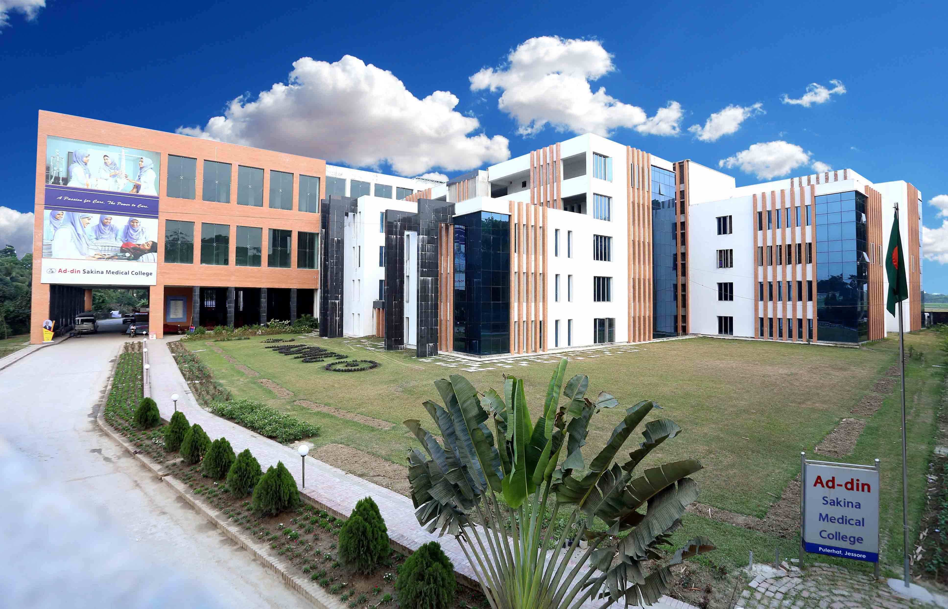
Thank You All

